Slide 1
An O( n log n) algorithm for finding dissimilar strings
Sarmad Abbasi , Anirvan Sengupta
Information Processing Letters 62 (1997) 135-139
Presenter: Hsiang-I Weng
Date: November 14, 2007

Slide 2








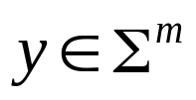


Abstract
Let be a finite alphabet and . A string is
said to be -dissimilar to , if no length substring of
is equal to any k length substring of . We present
an algorithm which on input and an
integer outputs an integer and such that:
(1) is -dissimilar to .
(2) There does not exist a string of length which is
- 1 dissimilar to x.

Slide 3
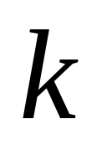
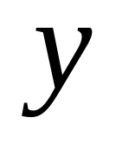
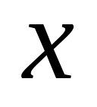







is -dissimilar to .
Example：
since contains all the substrings of length two over .
Furthermore, does not contain a run of three A’s,
hence is 3-dissimilar to ; therefore, for all .

Slide 4
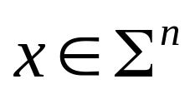

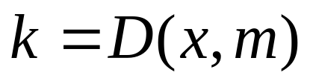
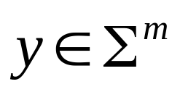




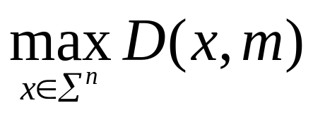
Dissimilarity Problem
Given and an integer ,
compute and a
such that, is -dissimilar to .
We present an algorithm for the Dissimilarity Problem.
The analysis of our algorithm depends on upper bounding the following combinatorial function:

Slide 5
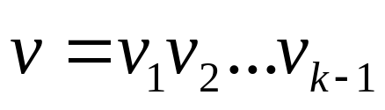

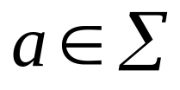
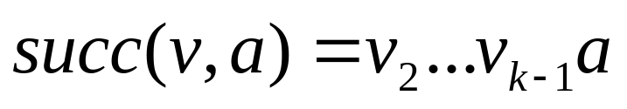
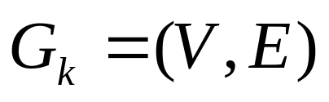
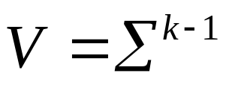


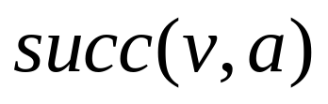
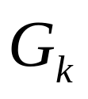
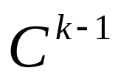

Definition
For any string of length
and , we define
Let be a directed graph with
the vertex set .
For every and there is a directed
edge from vertex to .
The graph has vertices with each
vertex having indegree and outdegree equal
to .

Slide 6



Example
AA . . BA
. BB
AB .

Slide 7



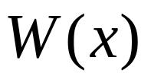
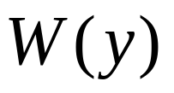

Lemma 3.
A string is - dissimilar to if and only if
and do not share a common
edge on .

Slide 8
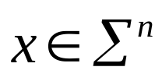



Algorithm A
Input : and two positive integer and .
Output : “Yes” If ,otherwise “No”.

Slide 9


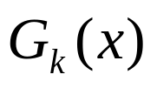
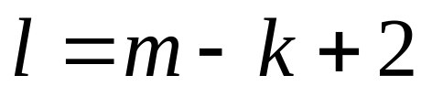
Algorithm A
Step 1: Construct the graph .
Step 2: Delete all the edges corresponding to
to construct .
Step 3: If the remaining graph; contains
a walk of length
Output “Yes”,
otherwise Output “No”.

Slide 10
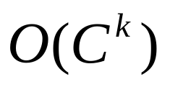
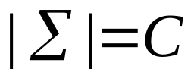
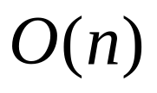
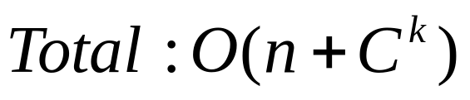
Analysis
Step 1 :
Step 2 :
Step 3 :

Slide 11
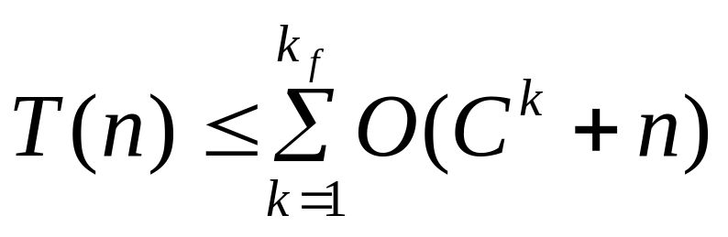
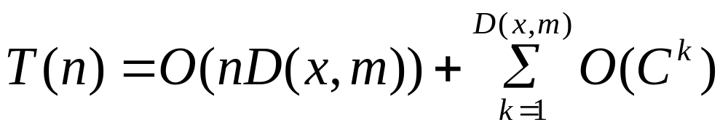
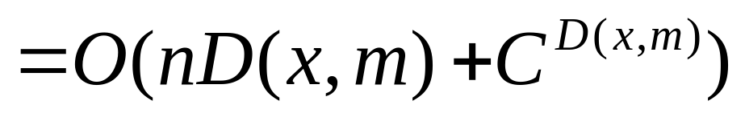
Analysis

Slide 12
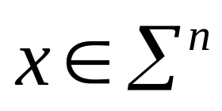
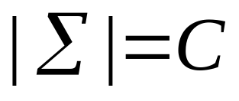
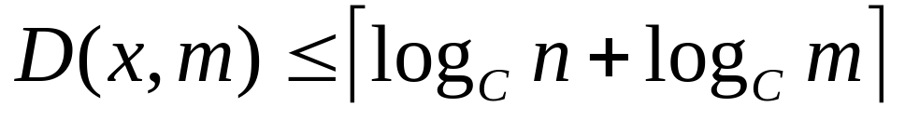
Theorem 4.
For any with

Slide 13
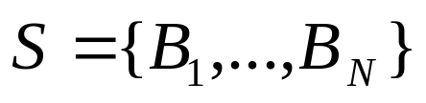
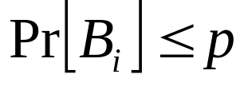

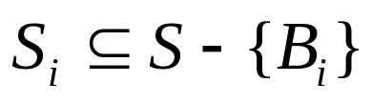
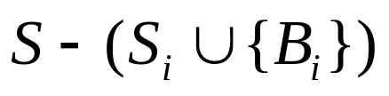

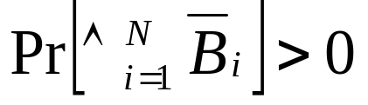
Lemma 5.
Let be a set events in arbitrary
probability space with .
Suppose for each there exists a set
of size at most d, such that
is independent of all the events in .
Furthermore, if
Then

Slide 14


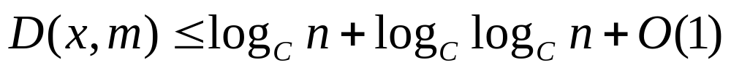
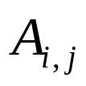
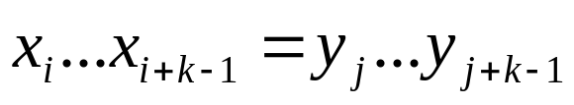
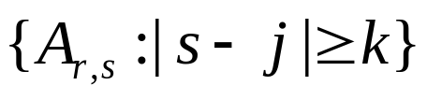
Theorem 6.
For every and for every
Proof.
Let be the event
Each event is independent of the set of events

Slide 15
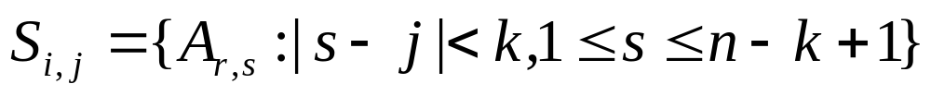
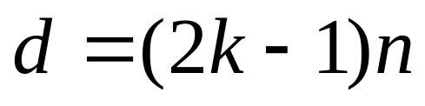
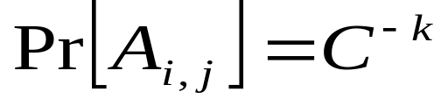
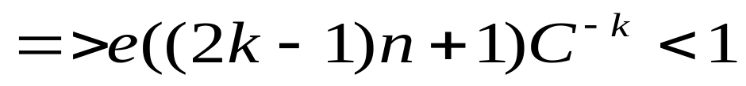
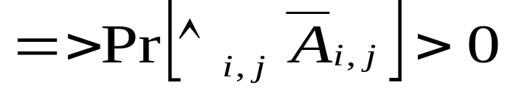
Theorem 6.

Slide 16
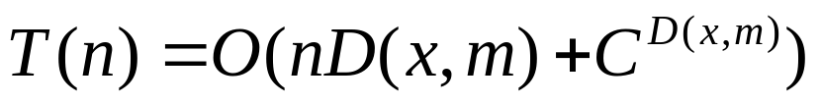

Conclusion

Slide 17
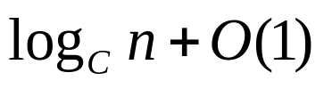

Question
How close is the bound of Theorem 6 to
the truth? A simple observation lets us
give a lower bound on the
function .

